Slide 1


Slide 2

Project Title: FurnishARt
Hafiz Talha Nazir (CIIT/SP21-BCS-007/ATD)
Muhammad Umer (CIIT/SP21-BCS-016/ATD)
Muhammad Noman (CIIT/SP21-BCS-014/ATD)
Supervisor: Ma’am Bushra Mushtaq
Department of Computer Science
COMSATS University Islamabad, Abbottabad Campus

Slide 3
Agenda of the Presentation
Motivation
Introduction
Scope
Key Functionalities
Modules
Tools and Technologies
Feasibility Analysis
Gantt Chart
First iteration 30%
Conclusion

Slide 4
Motivation
We aim to:
Revolutionize online furniture shopping with Augmented Reality.
Offer immersive shopping experience.
Augment virtual furniture with real-world spaces.
Empower informed purchasing decisions.
Boost user engagement which leads to improved sale rate.

Slide 5
Brief Introduction
Welcome to FurnishARt, an innovative AR-based Furniture Store Web Application designed to transform your online shopping experience.
The application goal is to enhance the online shopping experience by allowing customers to visualize products in their real-world environment before making a purchase.
The Proposed FurnishARt will include:
AR technology for furniture retail.
Interactive 3D models on our website.
Augmenting virtual products with real-world environments.
Immersive shopping experiences with AR.

Slide 6
Scope
FurnishARt will :
Be a single seller furniture store.
Integrate AR for viewing 3D furniture models on our website.
Enable placing furniture in your space using your smartphone camera.
Allow furniture size assessment before purchase.
Sole focus on furniture products.

Slide 7
Scope
Constraints/Limitations:
Android device with minimum v7.0 or above.
iOS device with minimum v11.0 or above.
Smart Mobile devices needed for AR mode.
Stable internet connection needed.

Slide 8
Module-wise Functionalities
Customer Module:
FR#1.1 User Registration and Authentication
FR#1.2 View Augmented Reality Preview Mode
FR#1.3 Explore Furniture Listings with Search Functionality and Pagination Support
FR#1.4 View 3D Models and Rotate Them on the Website
FR#1.5 Complete Furniture Purchase Process Securely Through Integrated Payment Gateway
FR#1.6 Review Furniture Items
Admin Module:
FR#2.1 Furniture Listing Management
FR#2.2 3D Model Management
FR#2.3 Customer Reviews Management

Slide 9
Expected Challenges
3D Model Management: Uploading, storing, and loading 3D models efficiently from the admin panel to the frontend while ensuring some centralized storage.
React/Next.js and Three.js Integration: Ensuring that Three.js accurately loads the specified product models based on user interactions.
Communication Among React/ Next.js, Three.js, and AR.js/Unity: Coordinating communication across these technologies for implementing the augmented reality (AR) feature.
Optimizing 3D Model Loading: Ensuring fast and efficient loading of 3D models on the frontend to maintain performance and responsiveness.
Placement of Furniture model on Floor in AR feature: Accurately placing models on the floor in the AR feature involves detecting suitable surfaces.

Slide 10
Proposed Tools/Platform
Tools and Technologies | Technology | Version | Rationale
 | JavaScript | ES6 | Programming language
 | React.js /Next.js | 18 | Frontend Web Development
 | Node.js / Express | 20 / 4.1 | Backend Web Development
 | Report/Presentation | Microsoft365 | Documentation
 | PostgreSQL | 16.2 | DBMS
 | Visual Studio Code | 1.87 | Code Editor
 | Three.js/AR.js/Unity | Latest | 3D modeling and AR Preview
 | SQL | 2013 | Query Language

Slide 11
Technical Feasibility
Resources | Availability | Expertise
React/Node | Open Source | Intermediate
JavaScript | Open Source | Intermediate
Visual studio code | Open Source | Intermediate
PostgreSQL | Open Source | Beginner
Three.js/AR.js/Unity | Open Source | Beginner

Slide 12
Financial Feasibility
Resource name | Cost
React/Next.js | Free
NodeJS | Free
Postgre SQL | Free
Three.js/Unity/AR.JS | Free
Hosting services | Cost of hosting the store

Slide 13
Resource Feasibility
Resource Name | Availability
Laptop | Available
Development Team | 3 Members Available
Time | 8 months
Software/Tools/IDEs | Available

Slide 14
Operational Feasibility
User Accessibility: The system will be accessible to admins and customers, requiring only a laptop or cell phone with internet access.
User Feedback Mechanism: Feedback mechanisms will ensure AR features meet user expectations and can be refined based on real-world usage.
Marketing Strategies: Effective strategies will promote AR feature adoption among target customers.

Slide 15
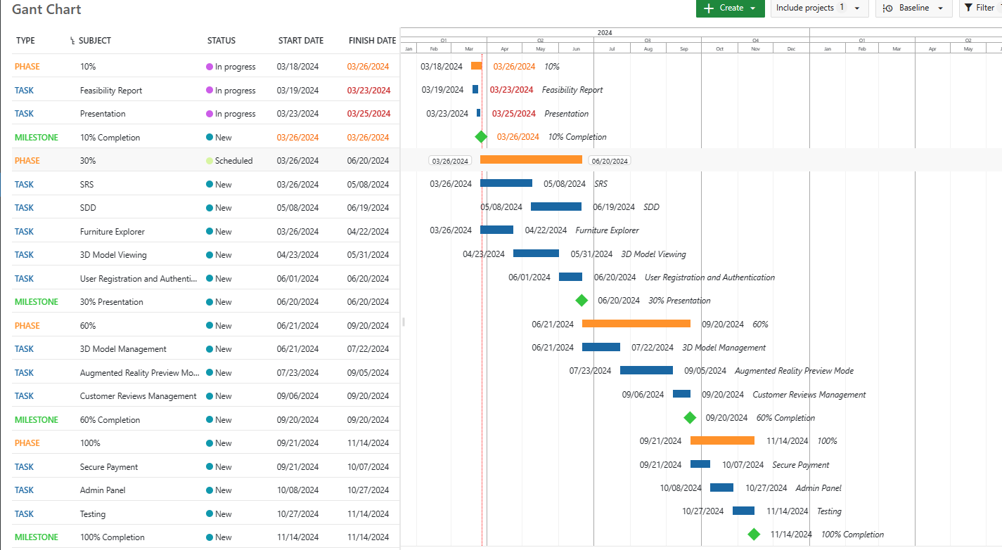
Schedule

Slide 16
Tasks for 1st Iteration (or 30%)
SRS and SDD Documentation
Furniture Explorer (Listing, Searching and Pagination)
3D Model Viewing
User Registration and Authentication

Slide 17
Conclusion
In conclusion, the proposed AR-based furniture store project utilizes augmented reality technology to enhance online furniture shopping. Users can visualize furniture in their living spaces before purchasing, improving decision-making. Through comprehensive exploration of AR, 3D modeling, and e-commerce integration, the project aims to deliver a user-centric platform. With seamless integration and immersive experiences, it has the potential to redefine online furniture shopping.

